Slide 1
Workshop 2
8.07.2019
Categories
Wishlist from ICBD participants from Workshop 1 (26 June)
Taken from end of powerpoint
Device helping to put on jumper/coat
Front fastening bra (clip less flimsy)
Stabilised shaver
Device for helping to put on socks & take them off
Improved keyboard and mouse (trackball?) adjusting stability of keyboard? Voice recognition? Sleep monitoring device to wake up in the right sleep phase (tailored to Parkinsons)
Falls and gait problems: help with timing/cueing/posture/Risk of Falling detection
Protective devices to protect against falls
Improved walker
Neutralising tremor with a device (peripheral nerve stimulation, e.g. Emma’s Watch)
Personal Care / Clothing
IT
Mobility / Fall prevention

Slide 2
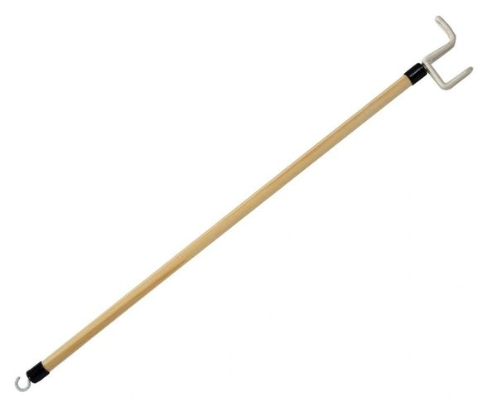
Workshop 2
8.07.2019
Personal Care/ Clothing
Device helping to put on jumper/coat
Dressing Stick ​
https://www.mobilitysmart.co.uk/comfort-and-dressing.html

Slide 3
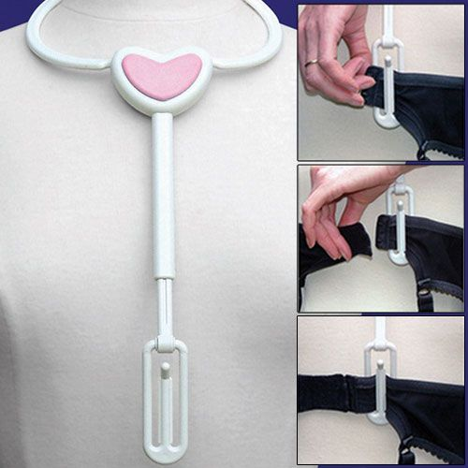
Workshop 2
8.07.2019
Personal Care/ Clothing
Front fastening bra (clip less flimsy)
Bra dressing aid
Holds one end of the strap ready and in place, so that the user can bring the other end round to fasten it very easily
https://www.completecareshop.co.uk

Slide 4
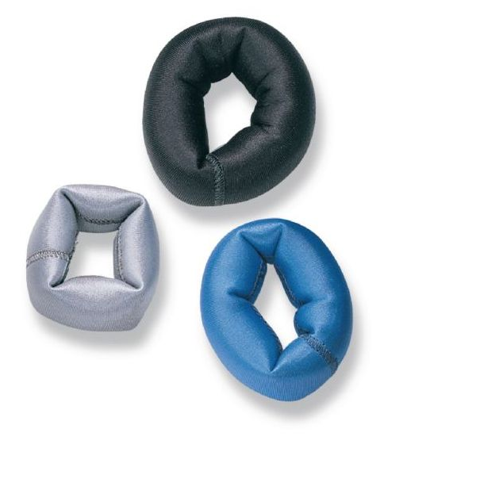
Workshop 2
8.07.2019
Personal Care/ Clothing
Stabilised shaver
Wrist weight set
Weights on the hand and wrist can lessen tremors and improve function.
https://www.performancehealth.com

Slide 5
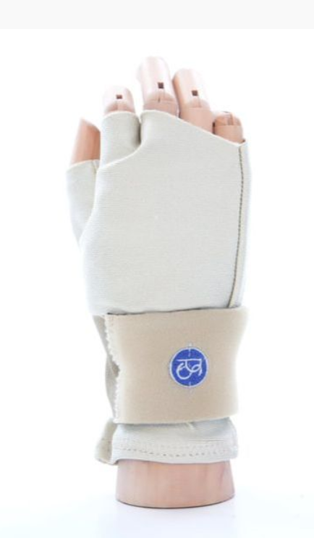
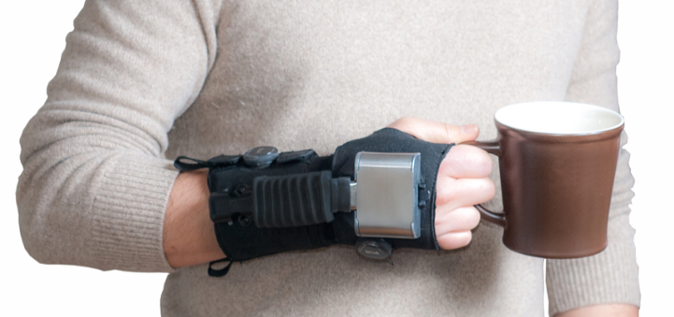
Workshop 2
8.07.2019
Stabilised shaver
No current solution except tremor reduction.
Gyroglove and Steadiwear- not available yet, £££??
Readi-Steadi available now for 300USD Steadyrest available now for £30.
https://gyrogear.co/gyroglove
https://www.readi-steadi.com/
https://youtu.be/yCNYjkGa9ZU
https://www.steadyrest.org/
https://steadiwear.com/

Slide 6
Sleep monitoring and waking up in a "good phase"
Workshop 2
8.07.2019
https://www.sleepcycle.com/how-sleep-cycle-works/

Slide 7
Workshop 2
8.07.2019
IT: Making computers more usable.
Alter the computer settings
Software options
Ergonomic mouse/keyboard optionsns
Touchscreens
Eye tracking
Voice recognition

Slide 8
Platform specific instructions to alter parameters.
Workshop 2
8.07.2019
Keyboard: Search “Keyboard”-control panel
Slide repeat delay to Long and Repeat rate to Slow.
Mouse: Search control panel app/hardware and sound/mouse
Alter “Buttons tab”- Slow Double-click speed
Alter “Pointer options tab”-Slow pointer speed.
Windows 10
Enable snapping to the cursor jumps to target locations.
Increase the size of buttons and other targets

Slide 9
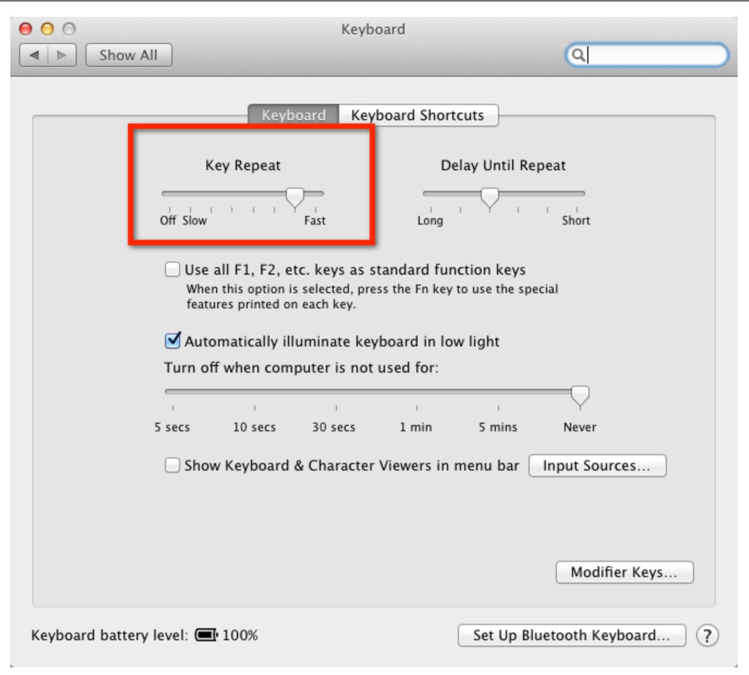
Apple MacOS
Keyboard settings:
Apple>System preferences>Keyboard
Reduce Key Repeat to "Slow" and Delay Until Repeat to "Long"
Mouse settings:
Apple>System preferences>Mouse
Reduce Tracking speed to "Slow"
Webpage showing how to alter Mouse settings on windows and Mac https://www.wikihow.com/Change-Mouse-Settings
very helpful showing step by step the Universal Access features https://cleartalents.com/mcmw/motor/making-your-keyboard-easier-to-use/changing-keyboard-settings/changing-keyboard-settings-osx/

Slide 10
Software options
Workshop 2
8.07.2019
SteadyMouse £40 no updates or £120 lifetime
Hardware options
AMAneo Assistive Anti-Tremor Mouse Adapter £200
https://www.youtube.com/watch?v=wW207mxmUi0
https://www.steadymouse.com/

Slide 11
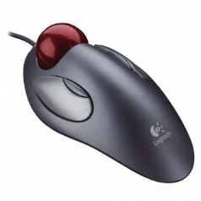
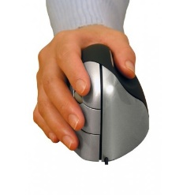
Ergonomic mouse options
Workshop 2
8.07.2019
Vertical mice realign the wrist to a more natural ‘handshake’ position, transferring movement onto the more powerful shoulder muscles.
Trackball, trackerball or rollerball mice remain stationary with the cursor controlled by rolling a ball with thumb, fingers or palm. This means there is little to no wrist movement.
Larger trackball mice are easy to use and may be particularly helpful. Can be strong and are often suitable for being operated by elbows or feet.
https://abilitynet.org.uk/sites/abilitynet.org.uk/files/Keyboard%20and%20mouse%20alternatives%20and%20adaptations%20April%202019_0.pdf

Slide 12
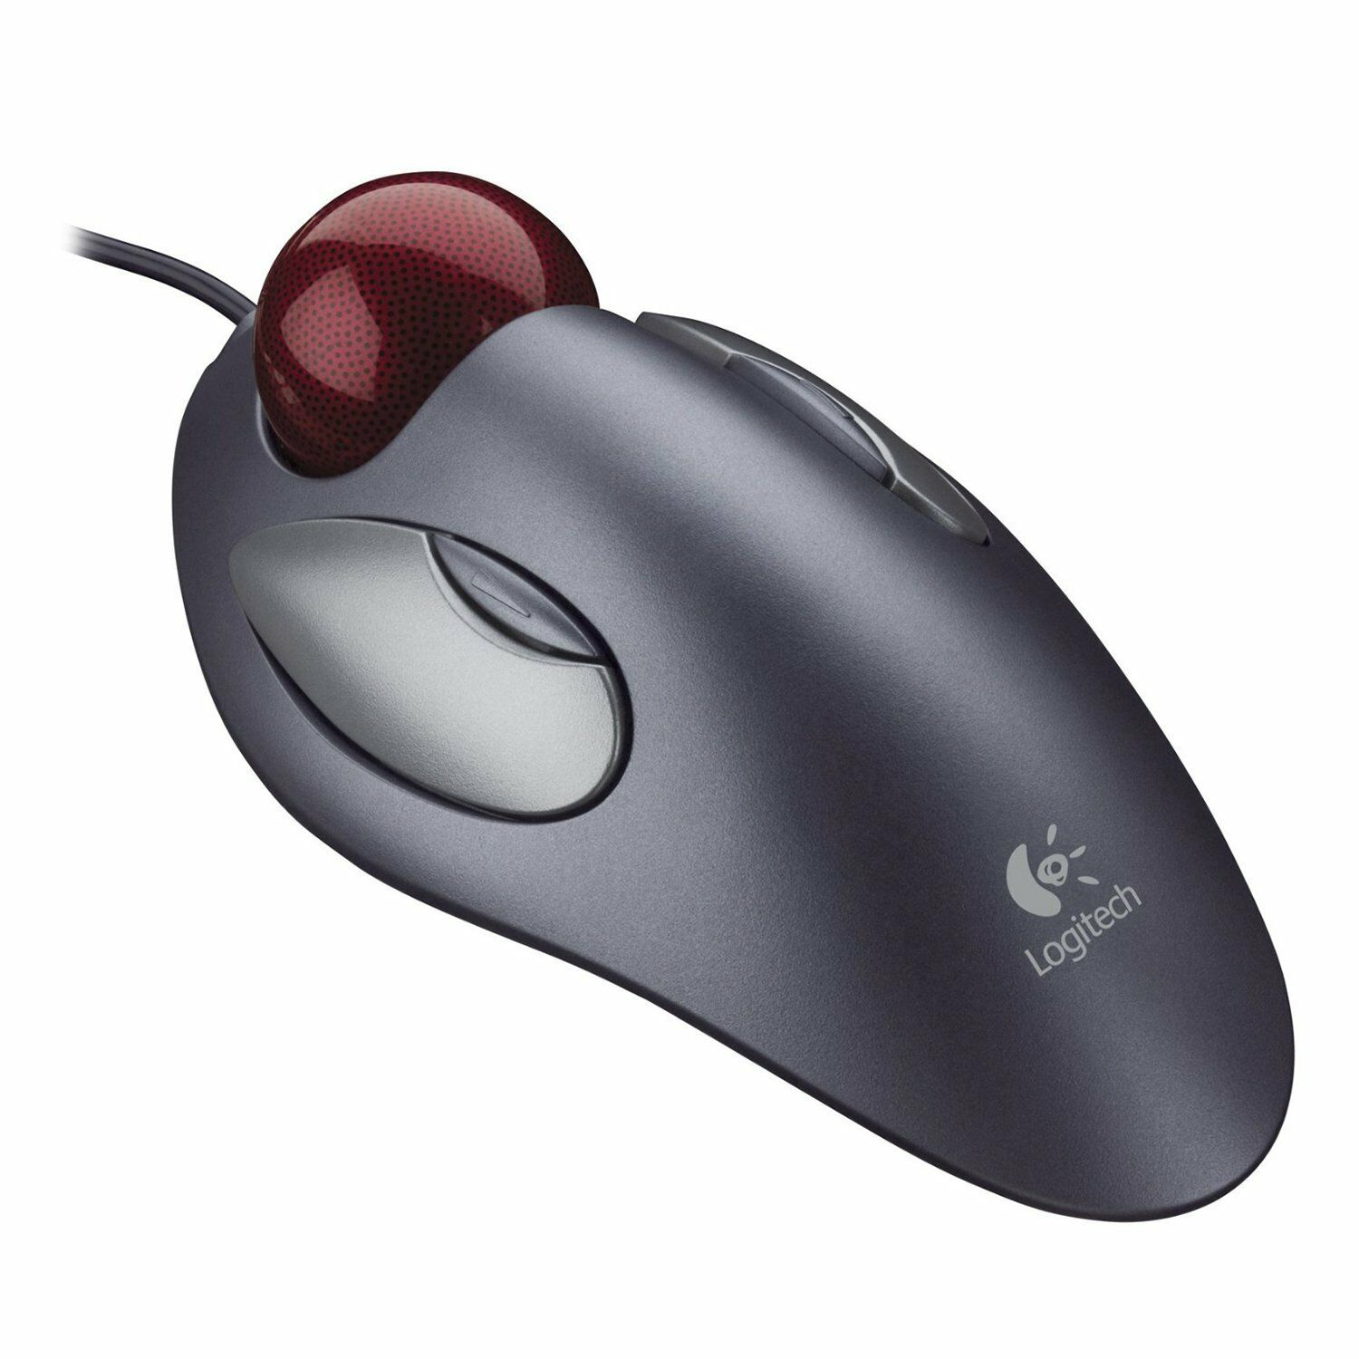
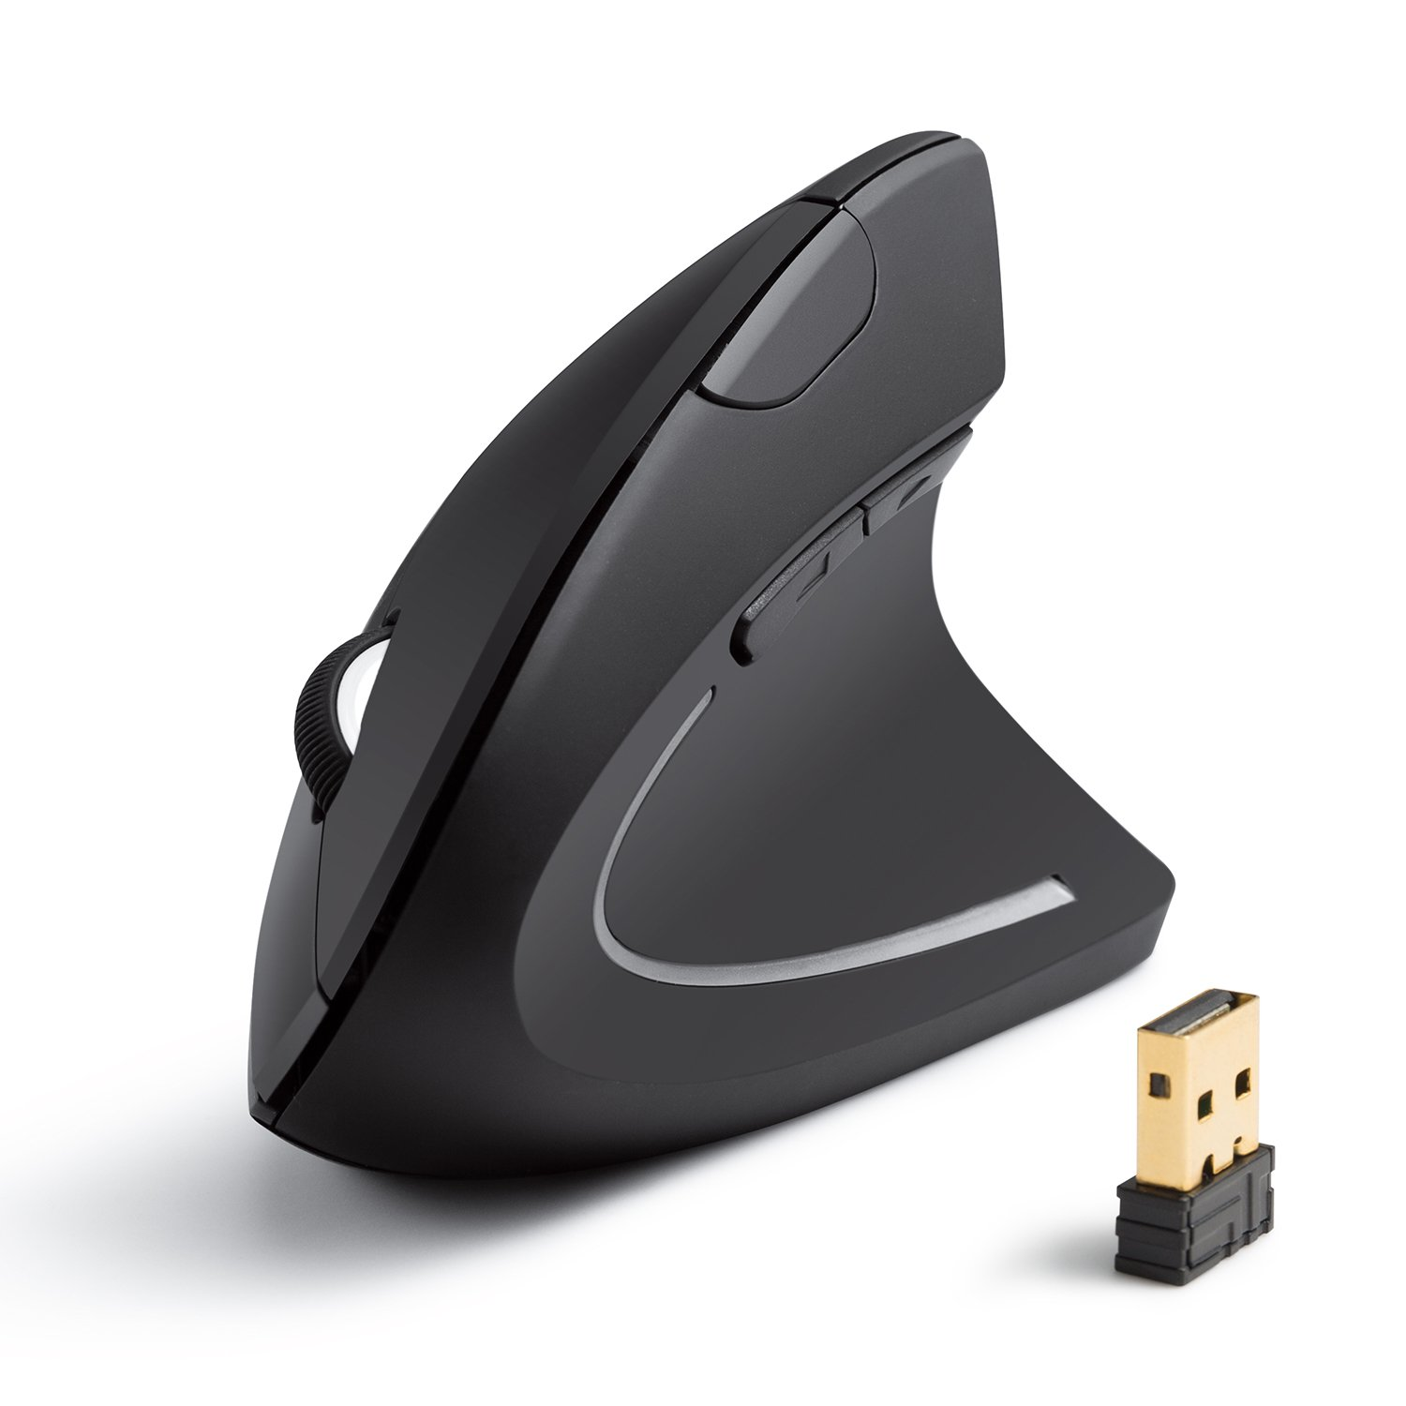
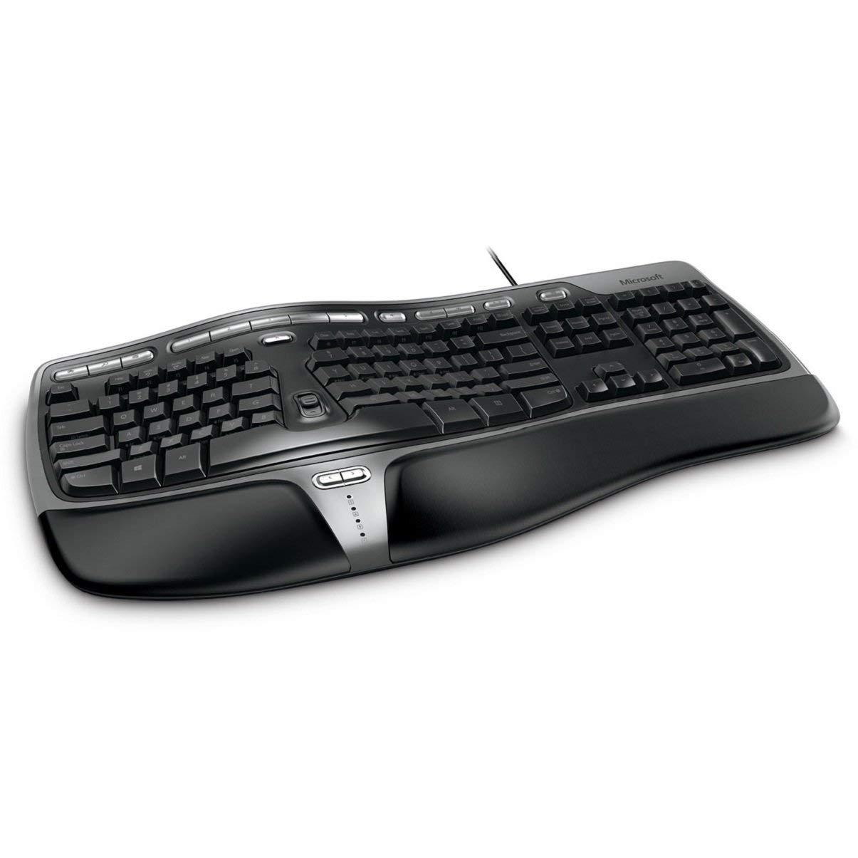
Ergonomic mouse/keyboard options £15-40
Workshop 2
8.07.2019
Kensington Orbit Optical Trackball (for larger hands)
Logitech Marble Mouse (seems to fit nicely those with smaller hands)
Anker AK-UBA 2.4G Wireless Vertical Ergonomic Optical Mouse
Microsoft Natural Ergonomic Keyboard 4000 (UK Layout)
http://www.medialt.no/en-US/pc-users-with-parkinsons-disease--tips-for-appropriate-adaptations/593.aspx
Images sourced from Amazon.co.uk

Slide 13
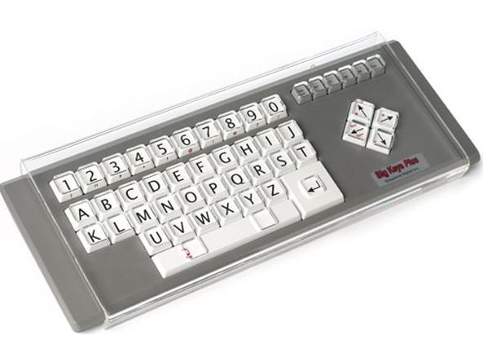
Ergonomic keyboard- Keyguard
Workshop 2
8.07.2019
http://www.inclusive.co.uk/standard-keyboard-and-keyguard
Bespoke keyboard guard for Apple Macbook Pro 15"
Initial designing/labour cost, then we could share designs openly
Bonus: not having to purchase a new keyboard, good for laptops.
Commercially available ~£70-200
http://www.inclusive.co.uk/big-keys-lx-p1997
Notes:
Keyguards are rigid plates with holes designed to work with specific keyboards. Holes are positioned over each key and significantly reduce the chance of accidental keypresses. The guard also allows you to rest your hands and arms on the guard without pressing any of the keys. Guards can be removed and fitted for use only when required. It is usually easier to purchase a keyboard and guard together rather than trying to get a guard to fit a specific keyboard.

Slide 14
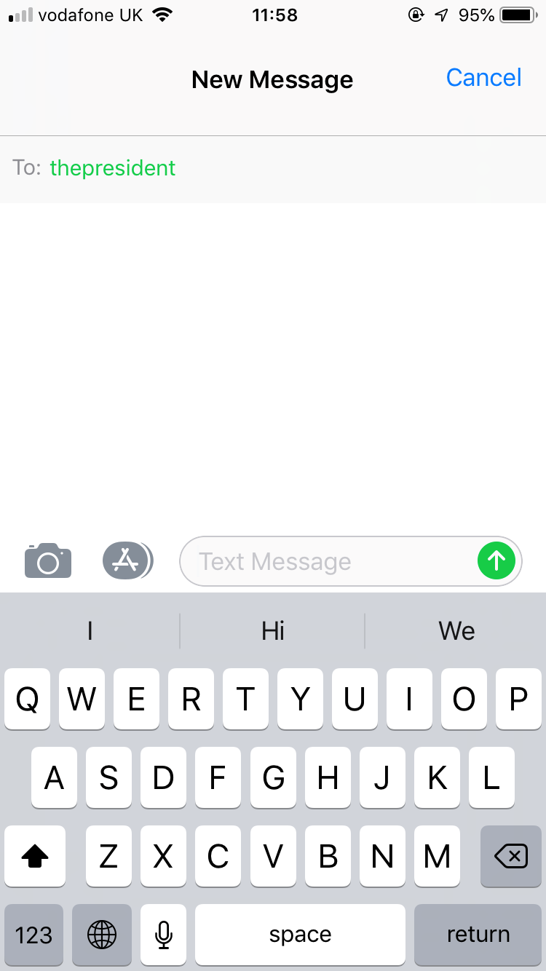
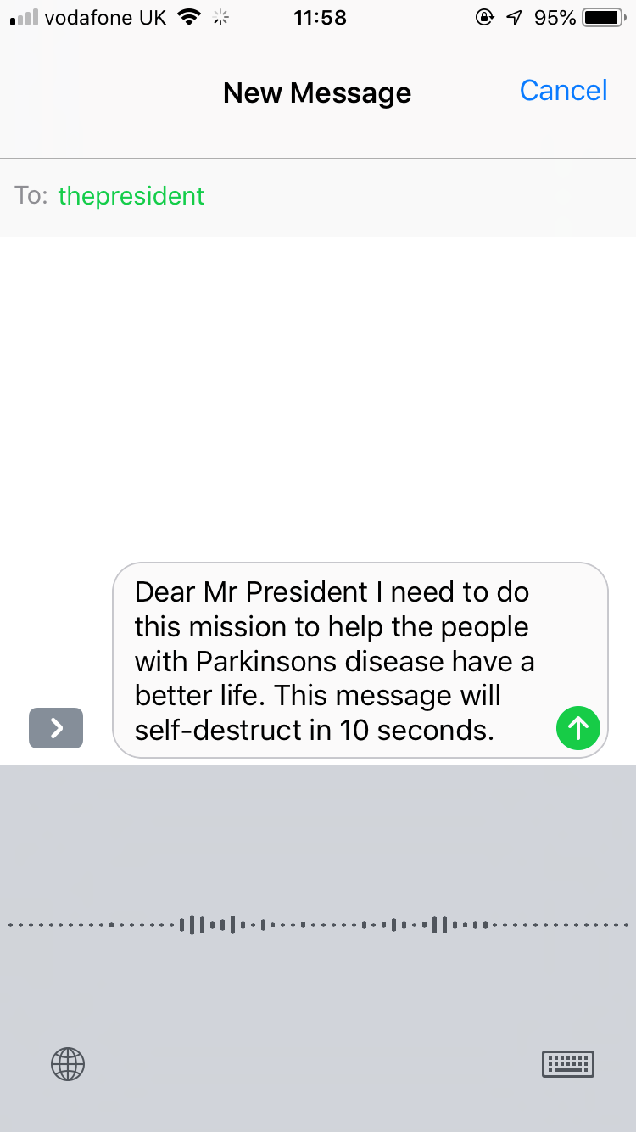
Workshop 2
8.07.2019
Dictation software
iPhone 7 example of text dictation during messaging.
Accuracy gets better with time
Frees up hands
Can get point across relatively easily

Slide 15
Workshop 2
8.07.2019
Mobility /Fall prevention
Falls and gait problems: help with timing/cueing/posture/Risk of Falling detection​
Protective devices to protect against falls ​
Improved walker ​
Neutralising tremor with a device (peripheral nerve stimulation, e.g. Emma’s Watch) ​

Slide 16
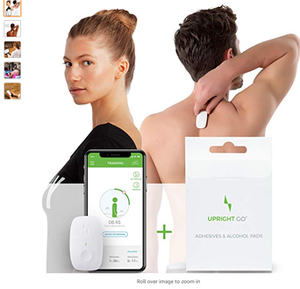
Measuring to feedback...
- Posture Monitoring
"Tracks posture, steps, distance, and calories burned. Vibrations from sensor gently remind you to sit straight and stand tall to help you look and feel your best. Lightweight and discreet: wear it as a fashion accessory or hide it under clothes"
https://www.amazon.co.uk/UPRIGHT-Wearable-Posture-Trainer-Android/dp/B0747YHYZF

Slide 17
Already available tips and tricks
https://www.parkinsons.org.uk/information-and-support/everyday-life
https://www.michaeljfox.org/news/7-home-safety-tips-people-parkinsons-disease

