Slide 1
Entertainments
Performers supporting our work and raising awareness of Parkinson's

Slide 2
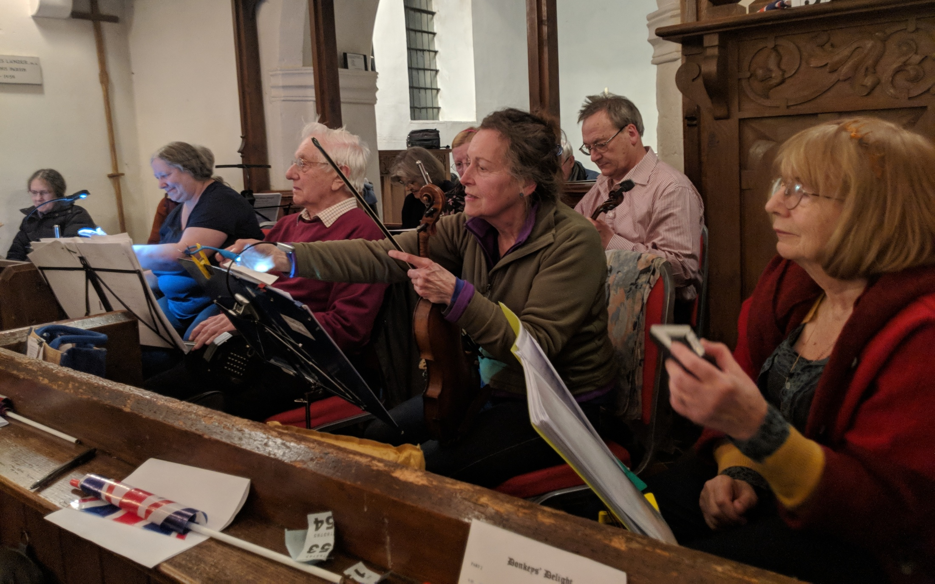
The Donkey House Players in South Hinksey Church

Slide 3
Comedy at the Edinburgh Fringe

Slide 4
Big Bold and Balance
Specialised exercise for Parkinson's
developed in partnership with
and now delivered county-wide

Slide 5
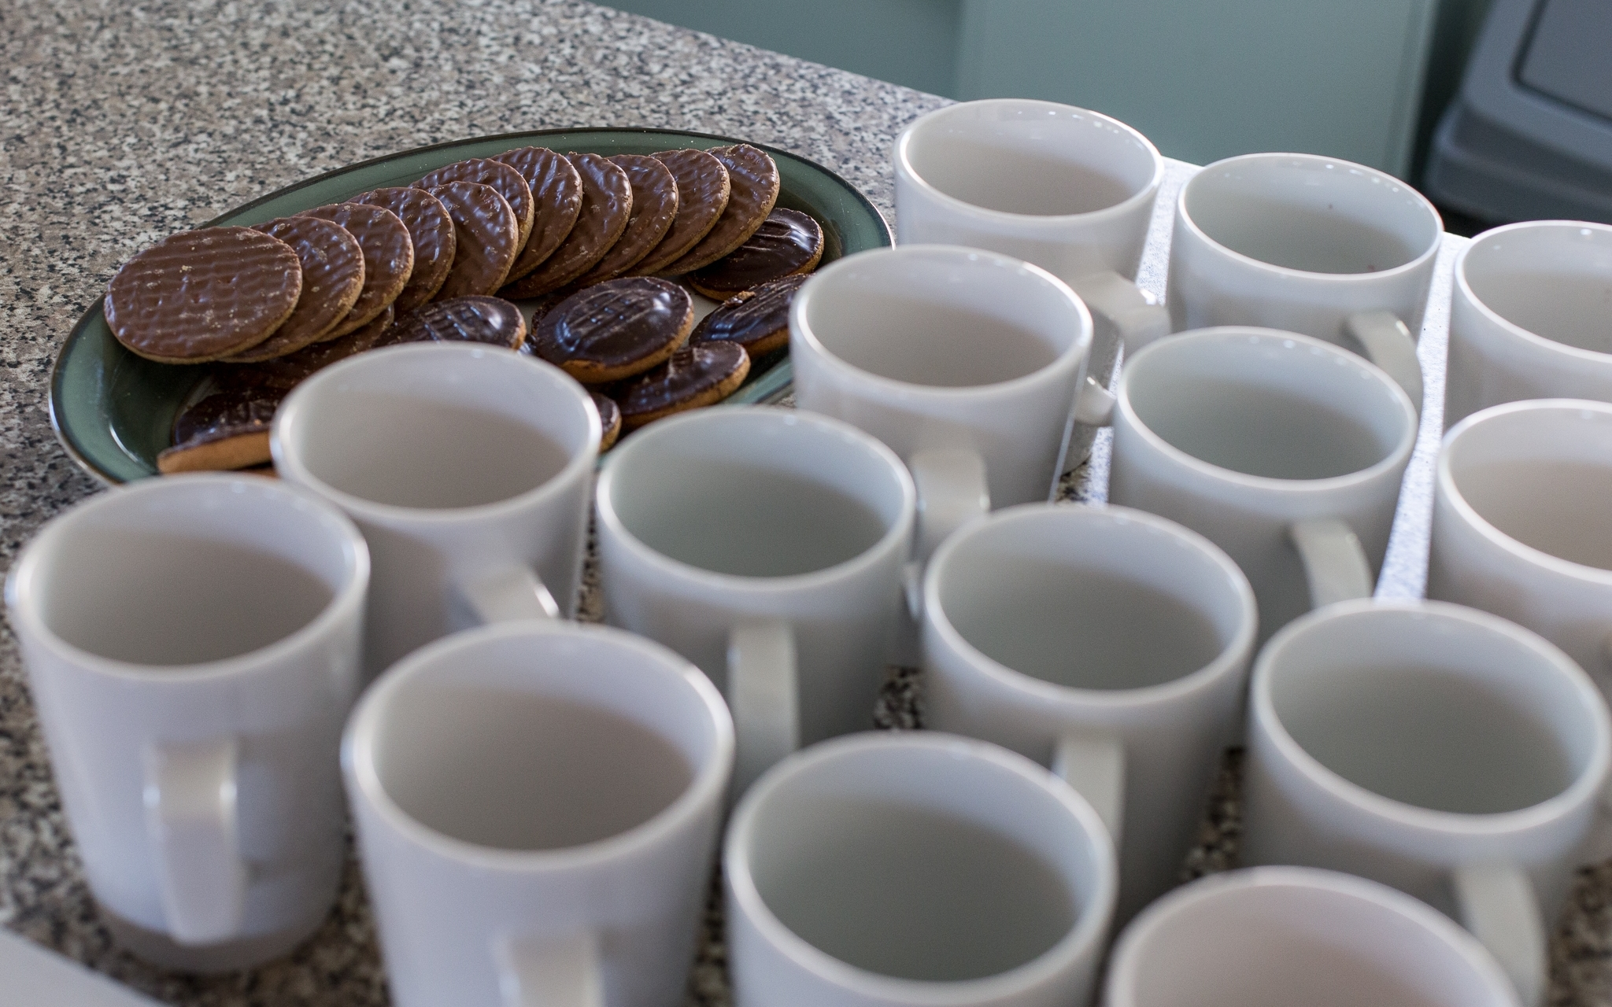
No exercise class is complete
without Jaffa Cakes

Slide 6
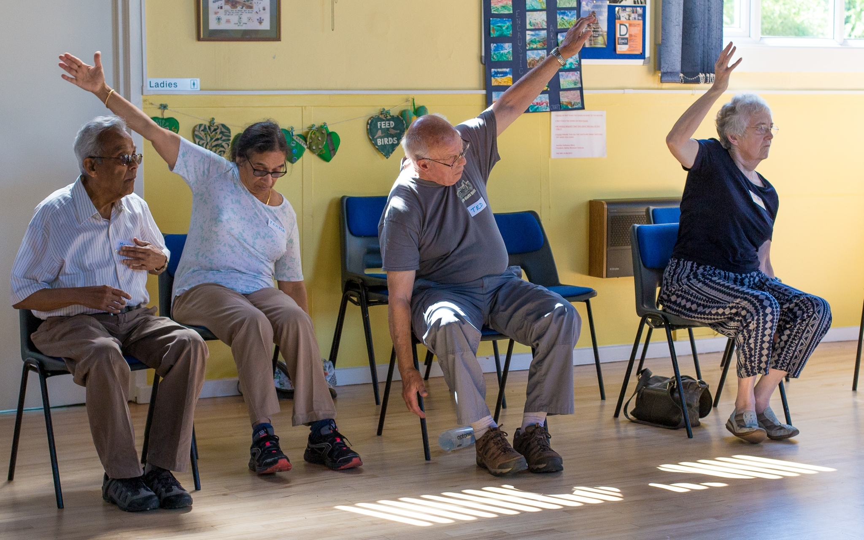
All together now...

Slide 7
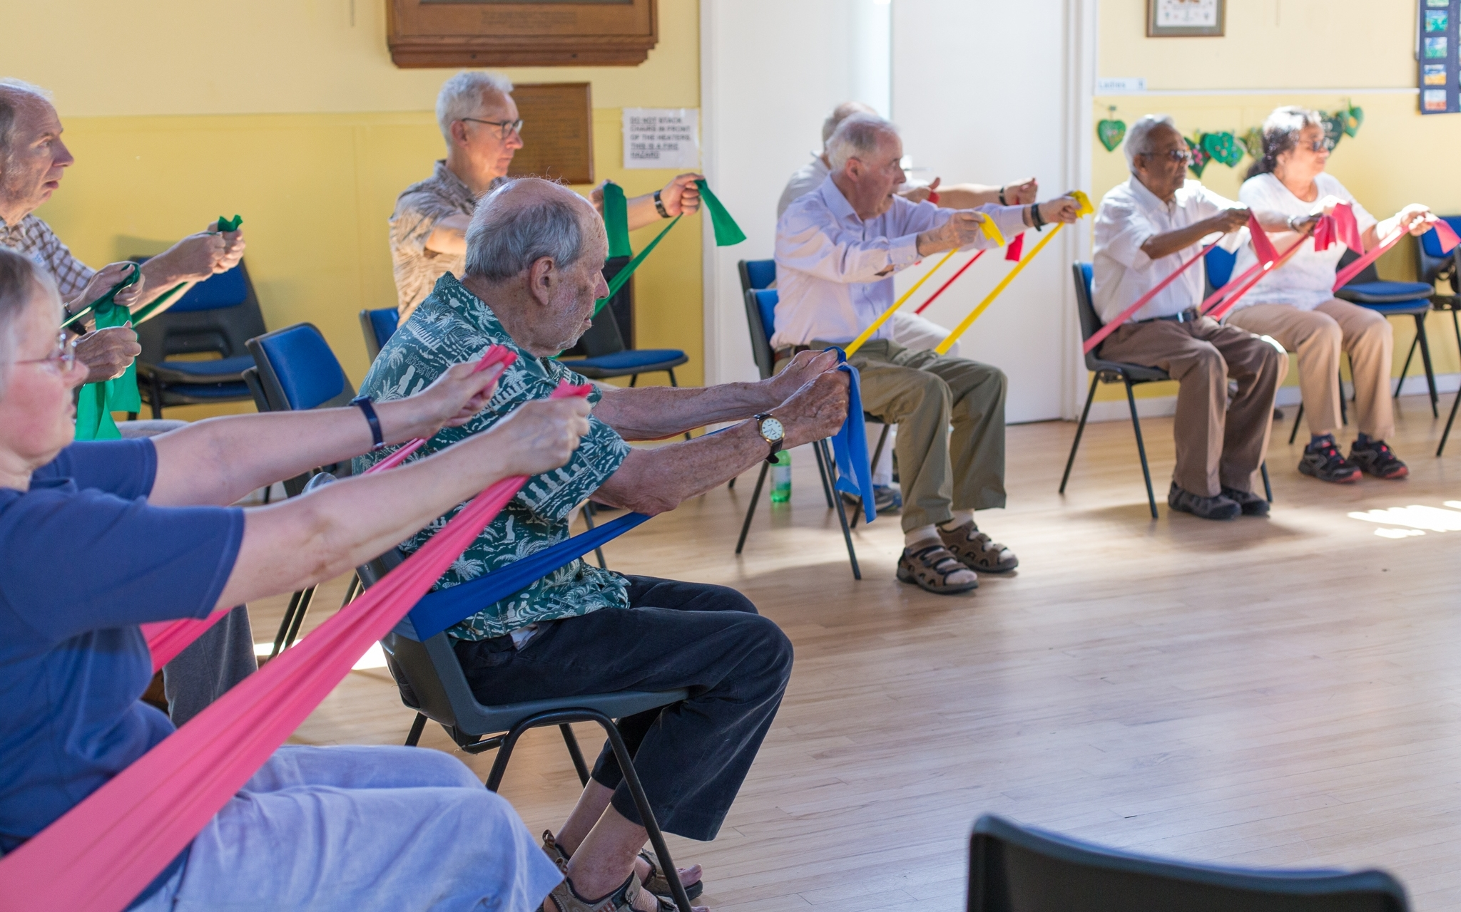
Big Bold and Balance:
stretching in colour!

Slide 8
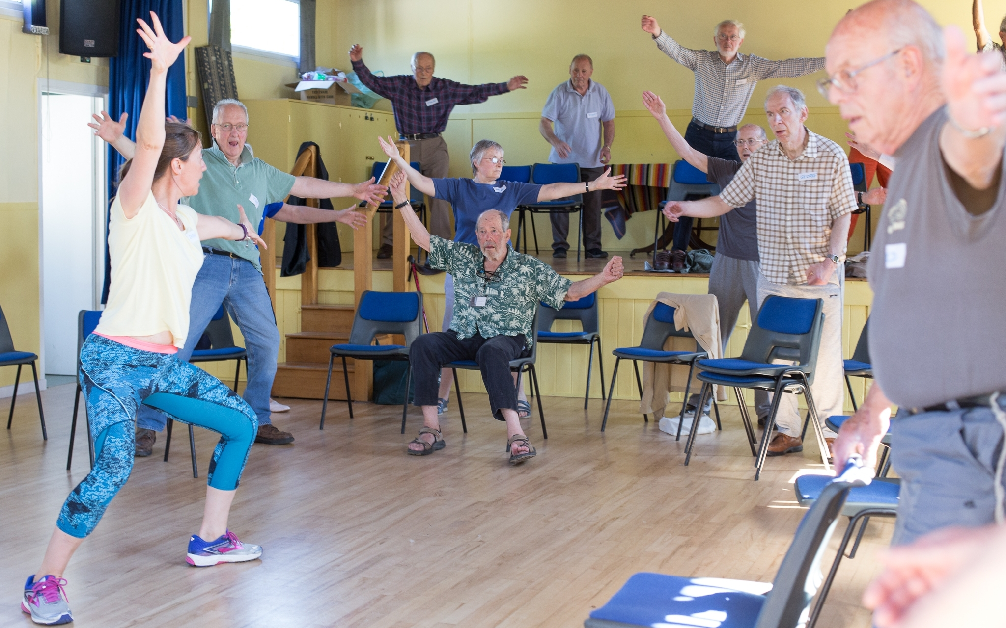
Big Bold and Balance:
exercise for all abilities

Slide 9
Working for PwP
Our most important aim:
to support people with Parkinson's
and their families and carers

Slide 10
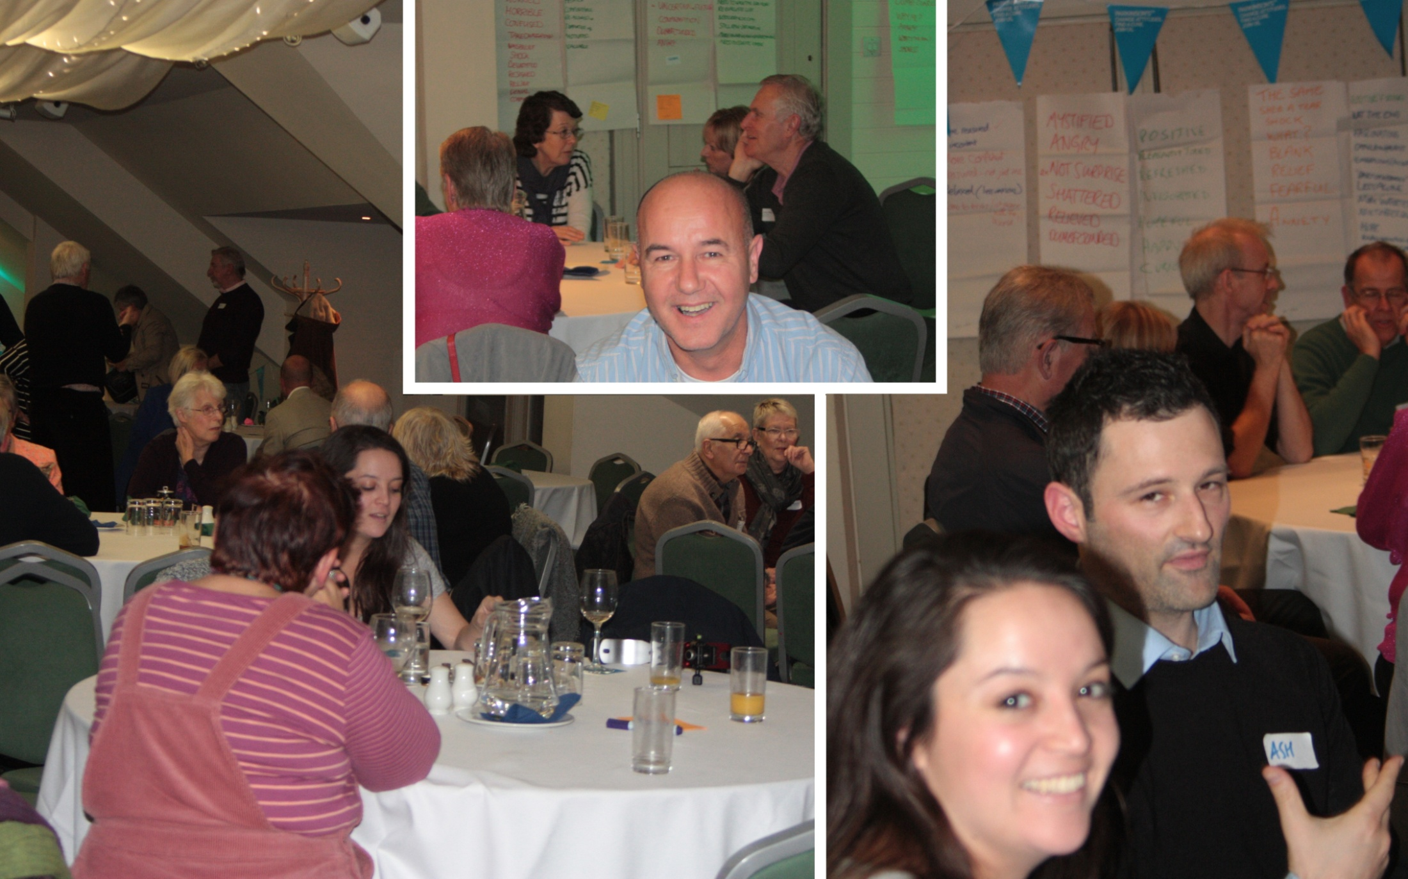
Reunion party for the First Steps programme

Slide 11
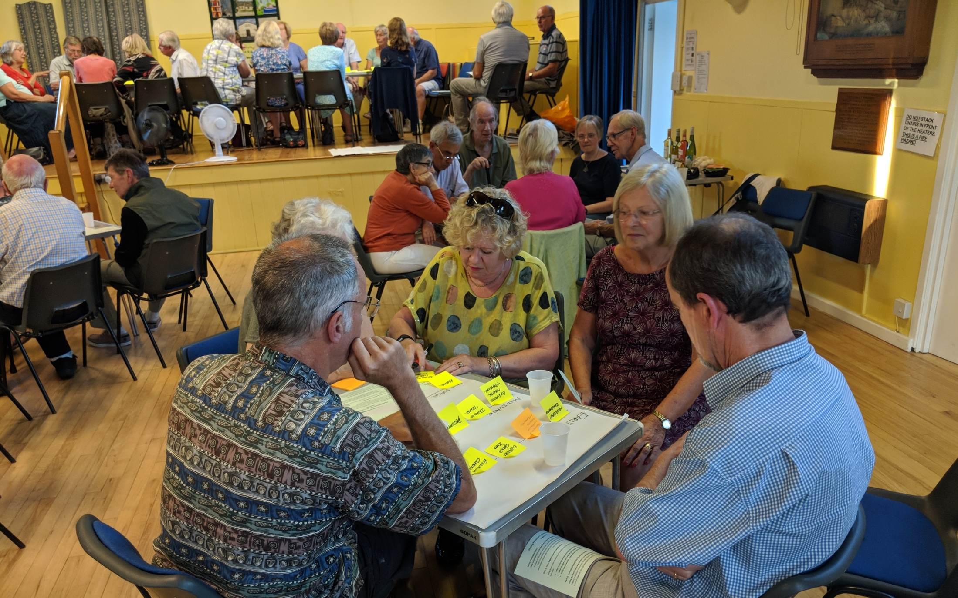
PwP discuss their priority concerns
at our August meeting

Slide 12
Just for fun
Our social activities allow
people with Parkinson's to meet
in a supportive informal setting

Slide 13
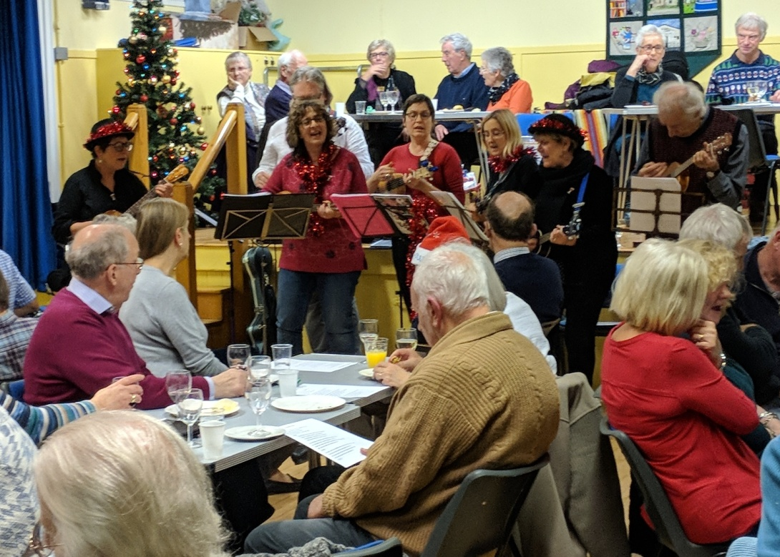
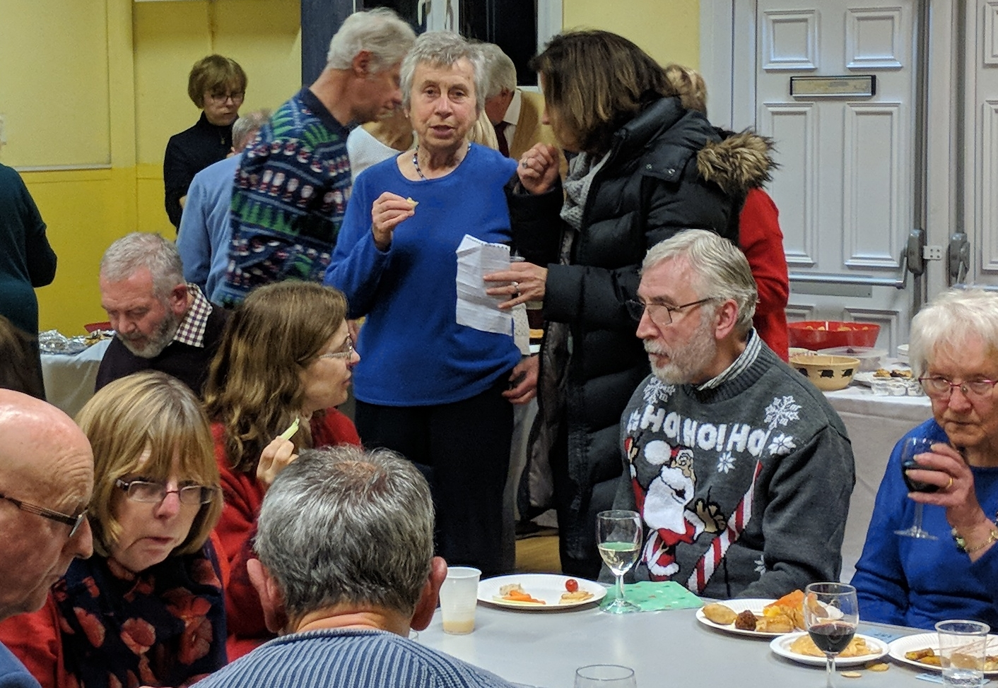
Our Christmas party

Slide 14
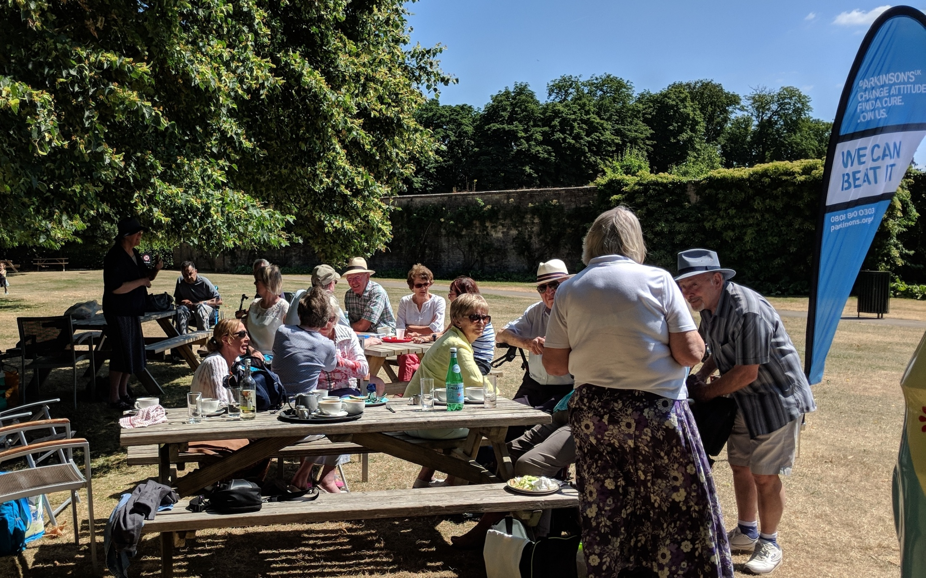
Picnic at Blenheim Palace

Slide 15
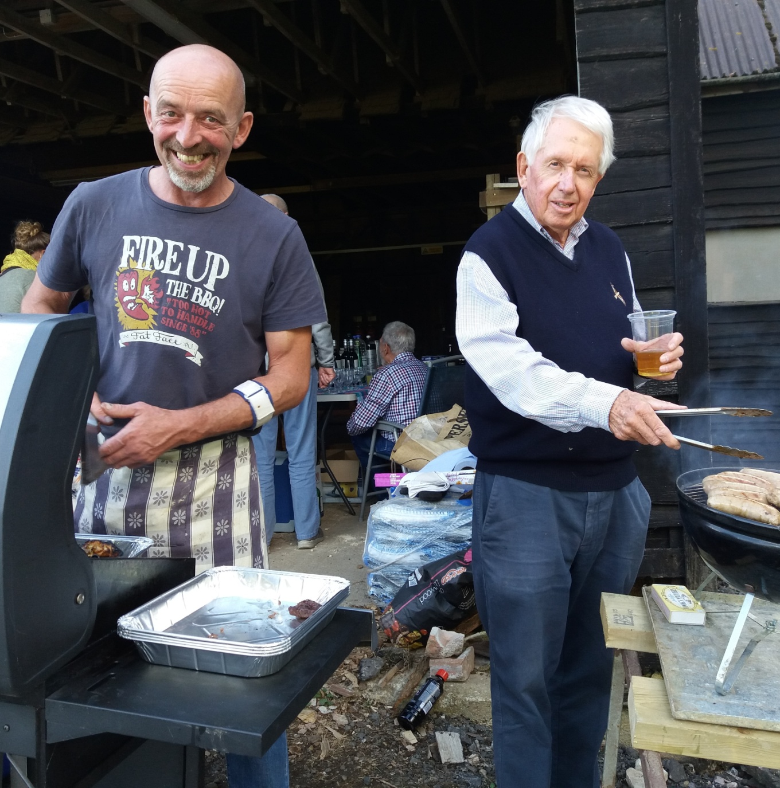
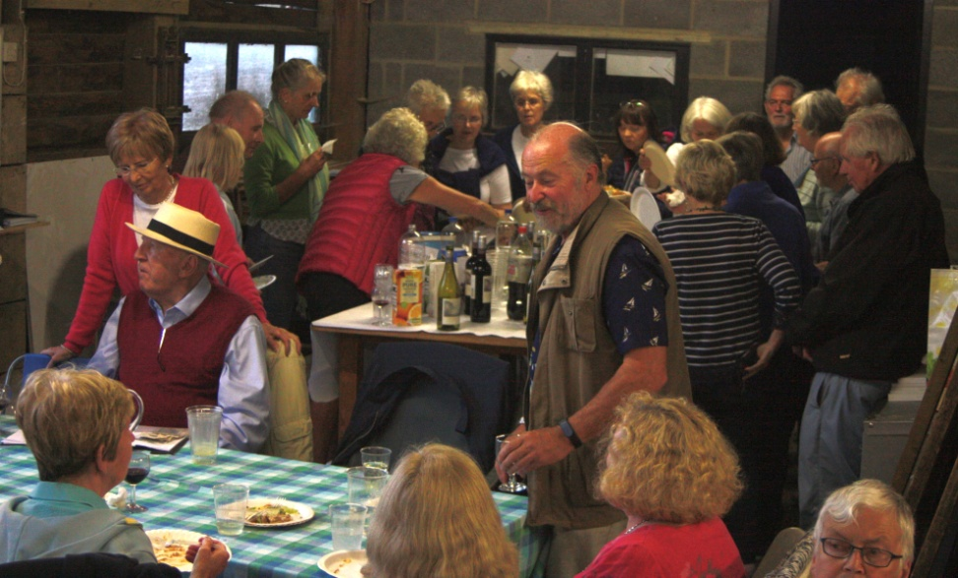
Summer Barbecue in Wytham Woods

Slide 16
Fundraising
Barbecues, teas, walks, challenges...

Slide 17
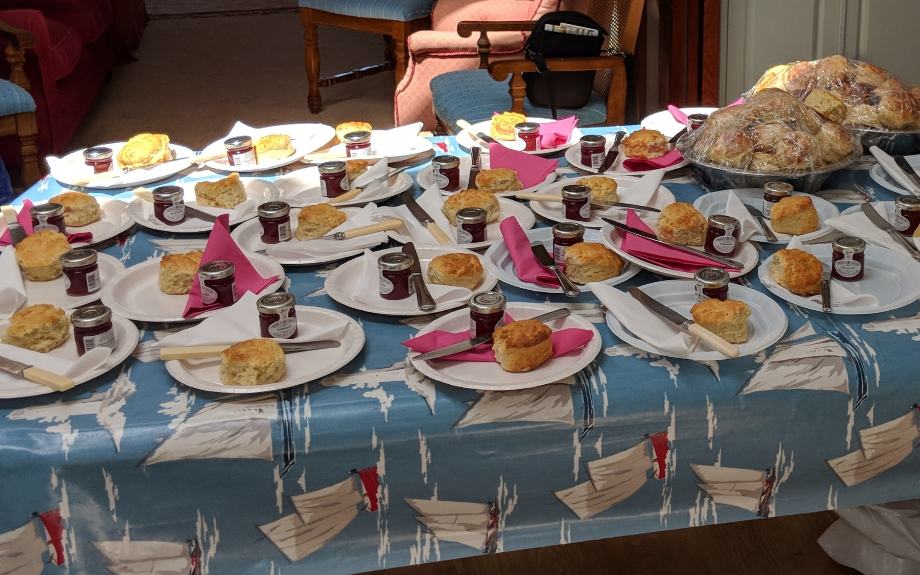
Expecting a few people for cream tea

Slide 18
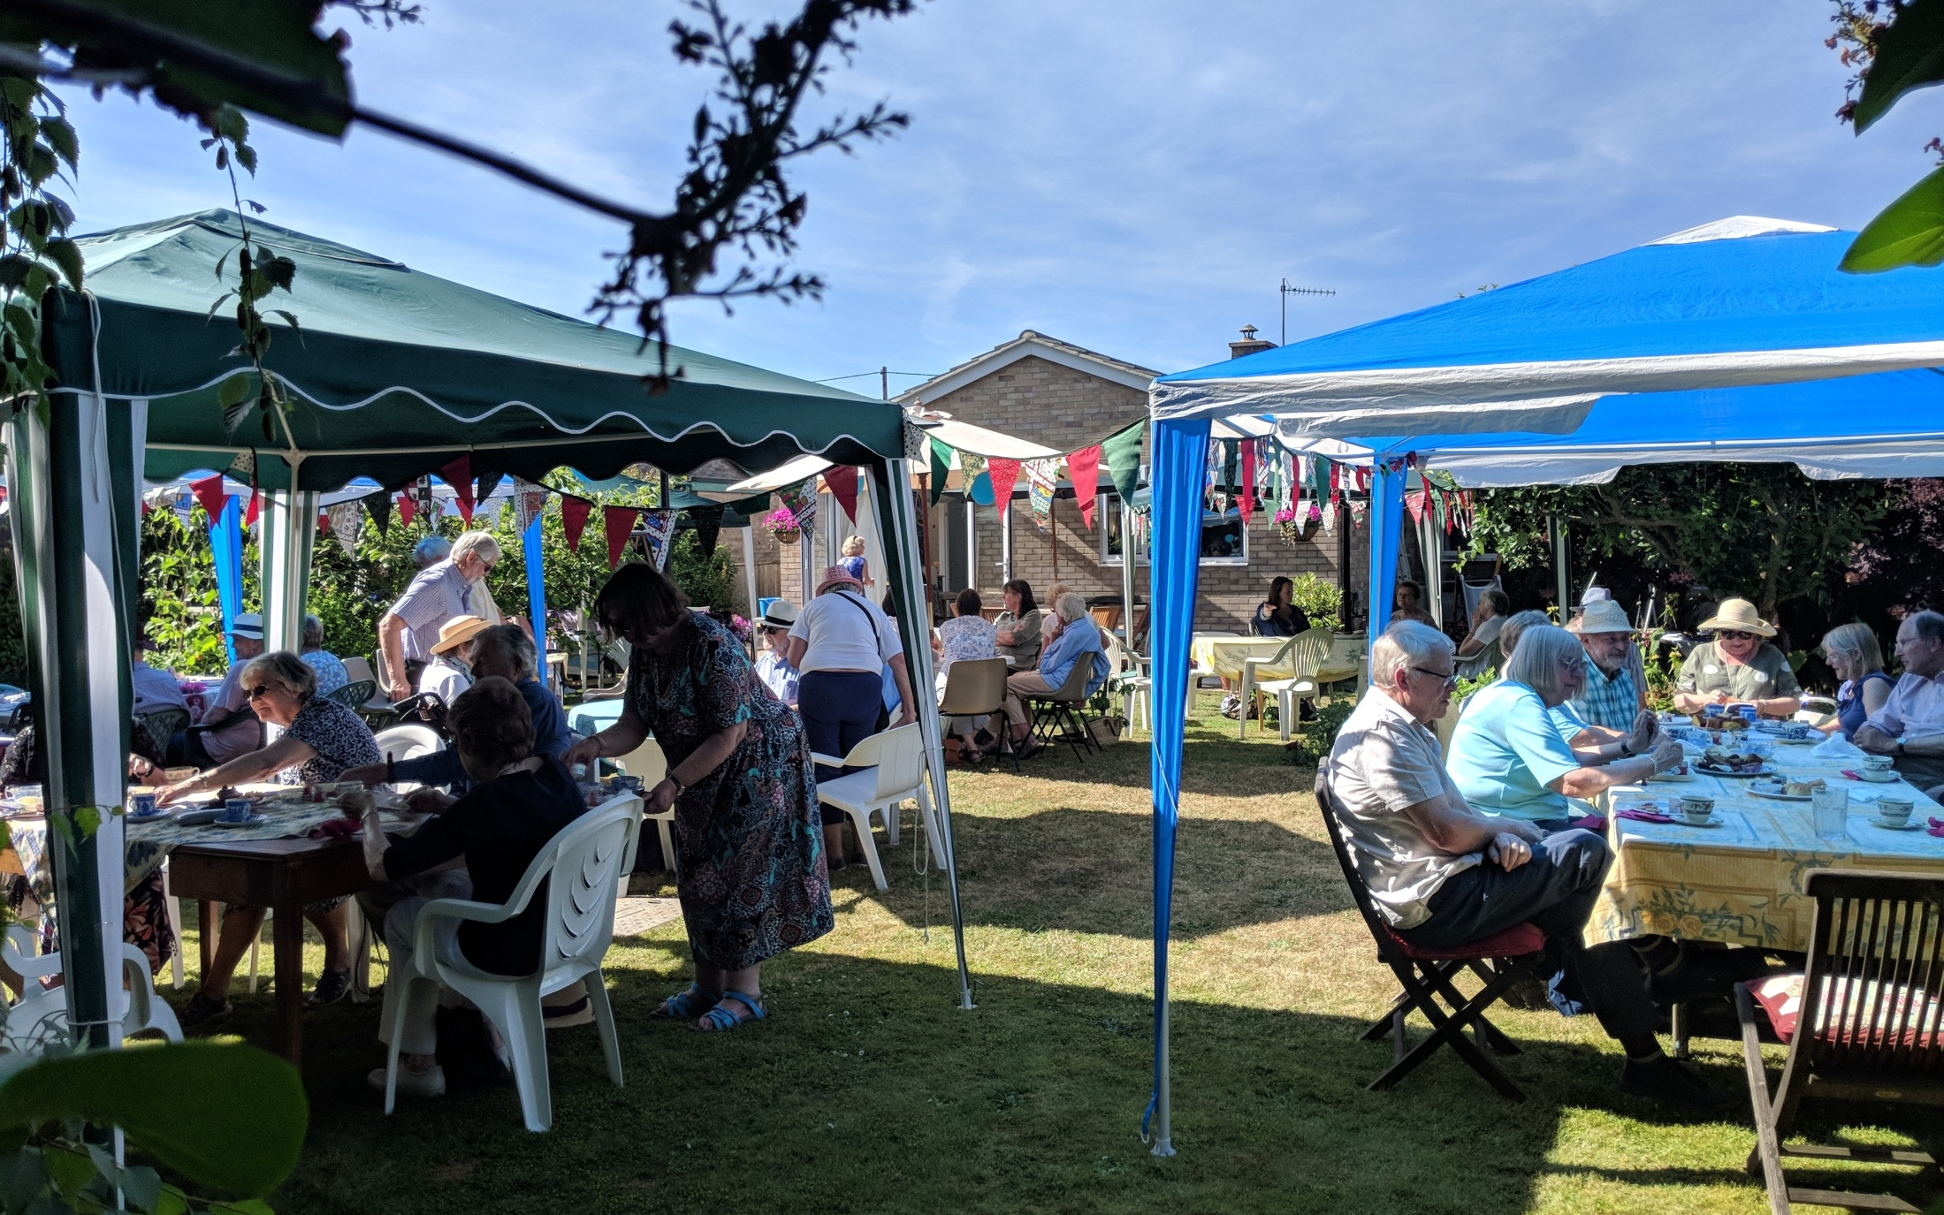
Cream Tea 2018 – over £450 raised

Slide 19
Amazing fundraising
by our members and friends –
all this in 2018 alone!
Details on our website

Slide 20
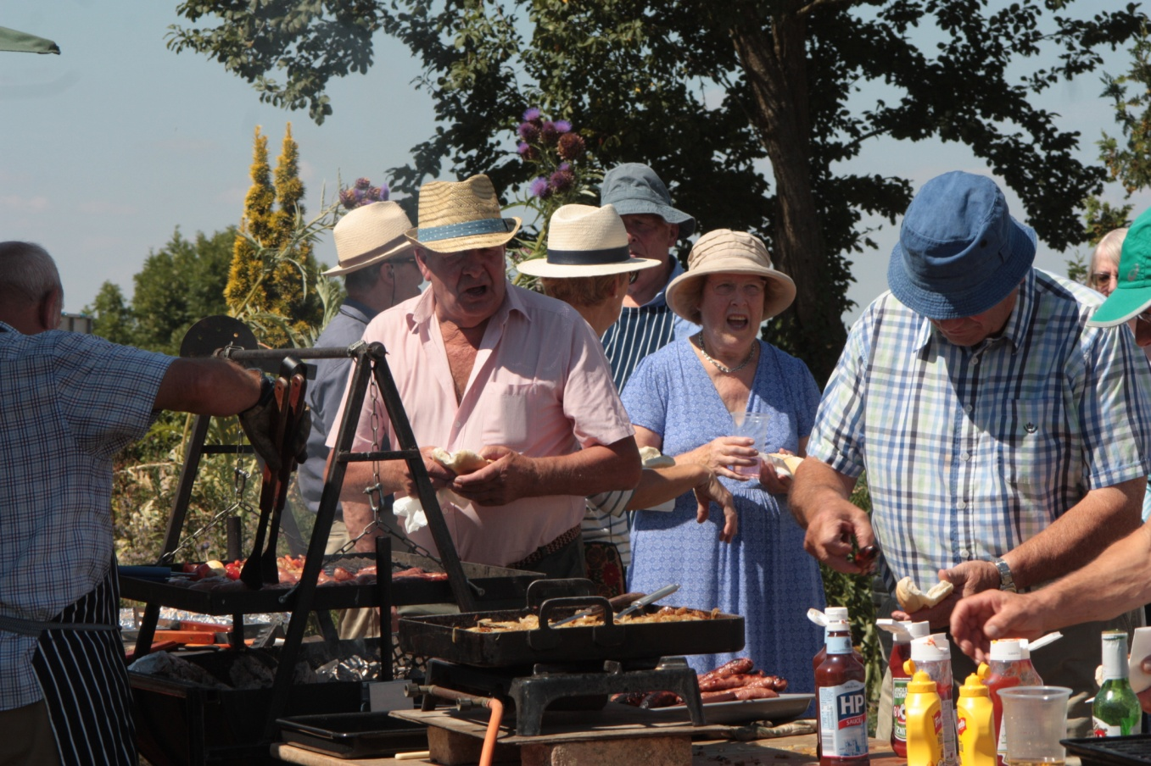
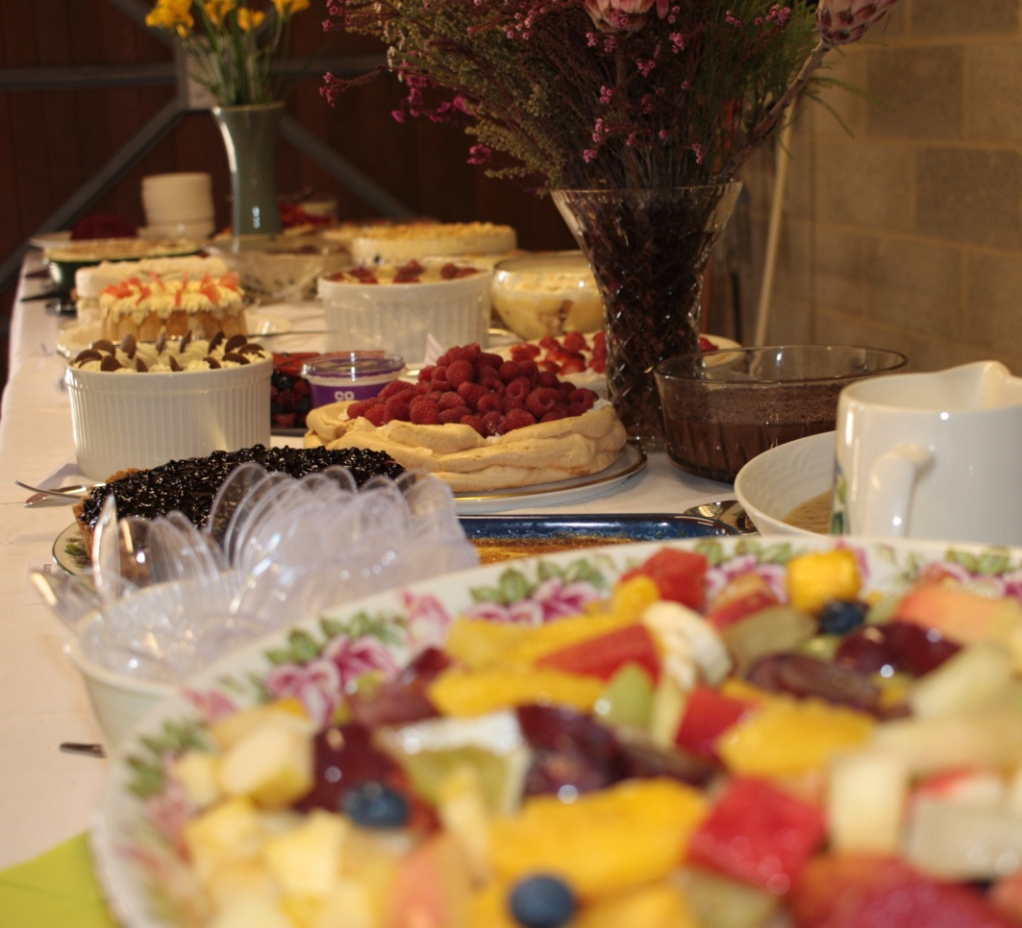
Hot Dogs and Puddings
raised over £2200

Slide 21
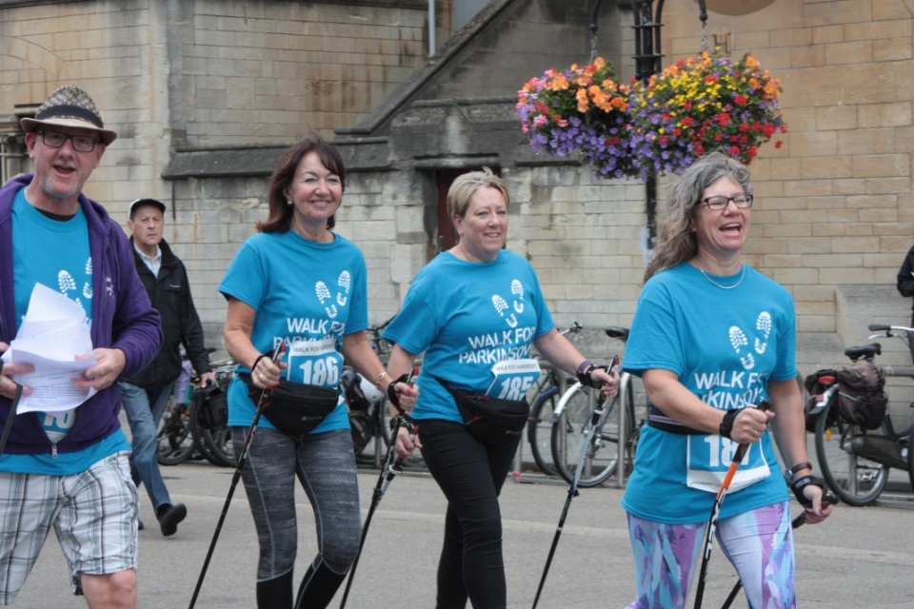
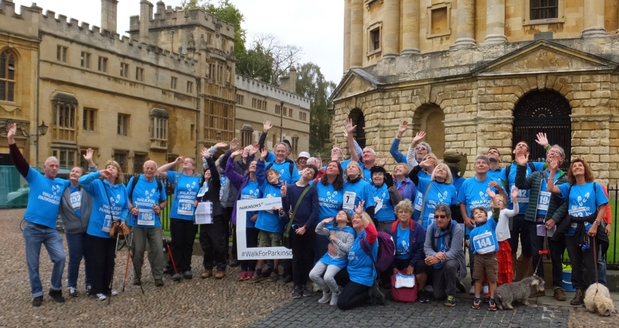
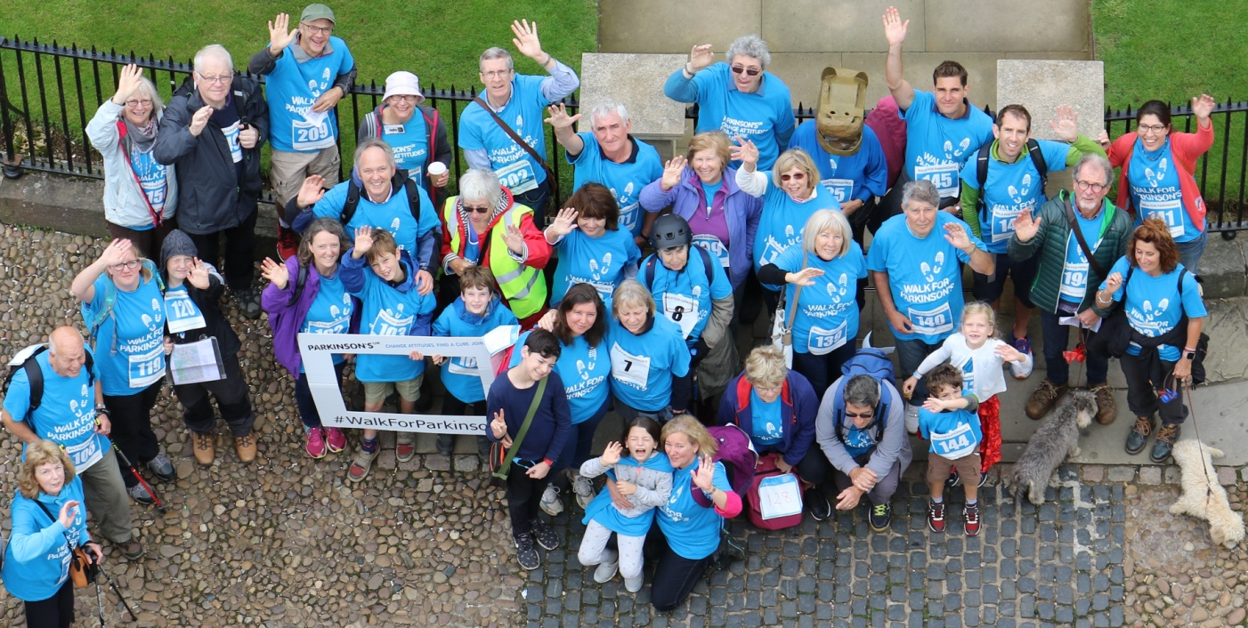
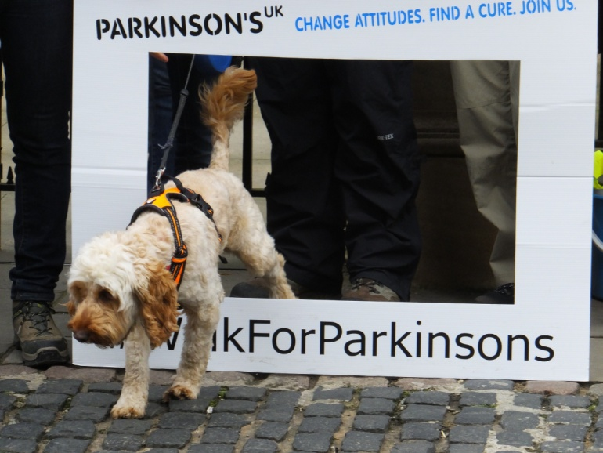
Walk for Parkinson's research fundraiser

Slide 22
Recognition
Prestigious awards for
our branch and its activities

Slide 23
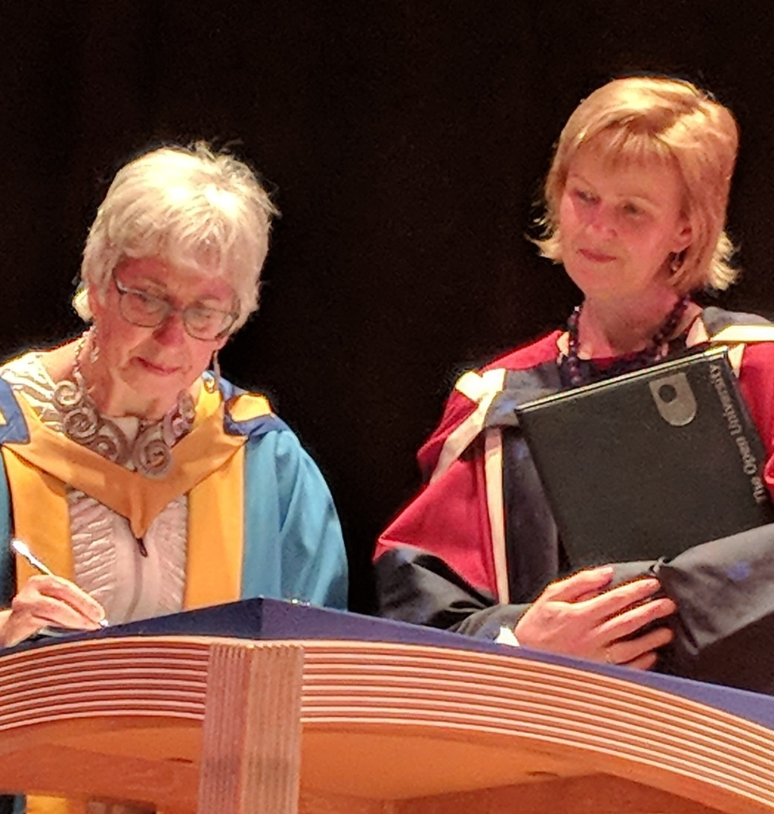
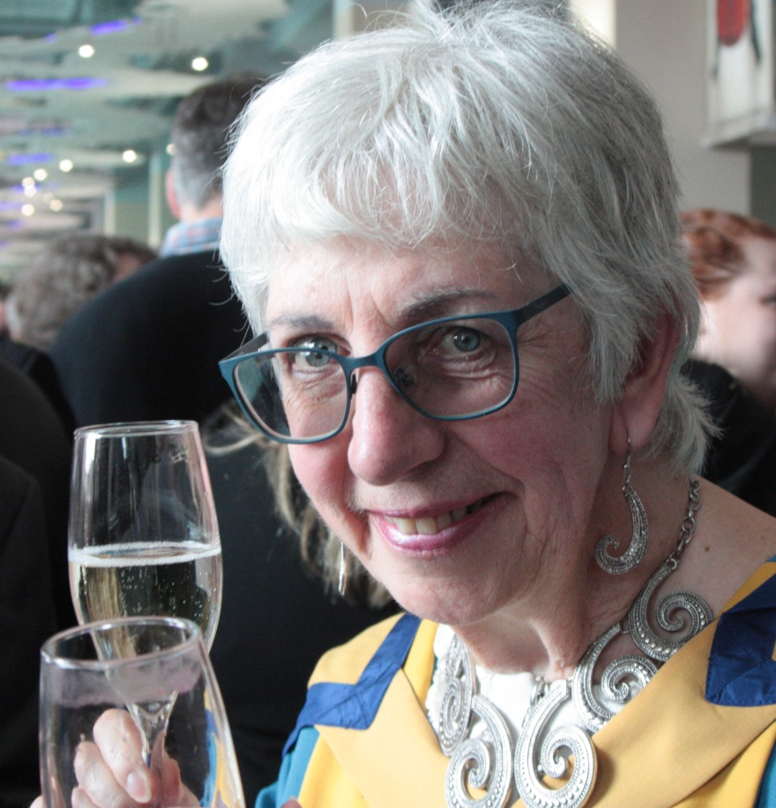
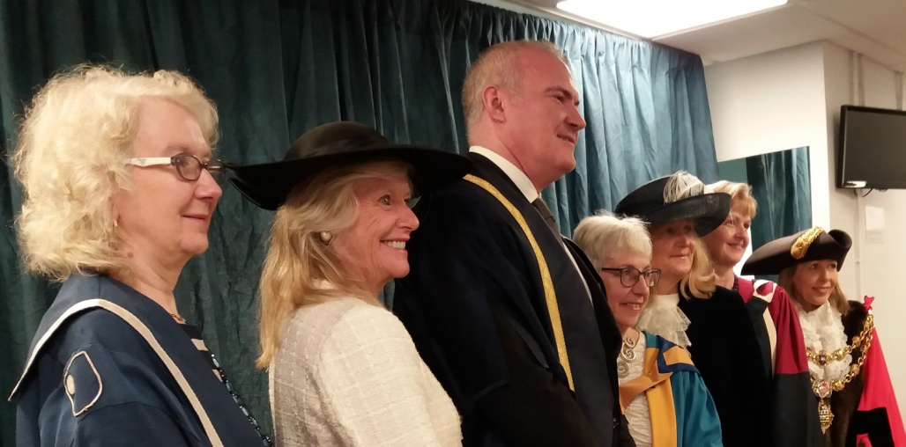
Our Chair awarded honorary OU degree

Slide 24
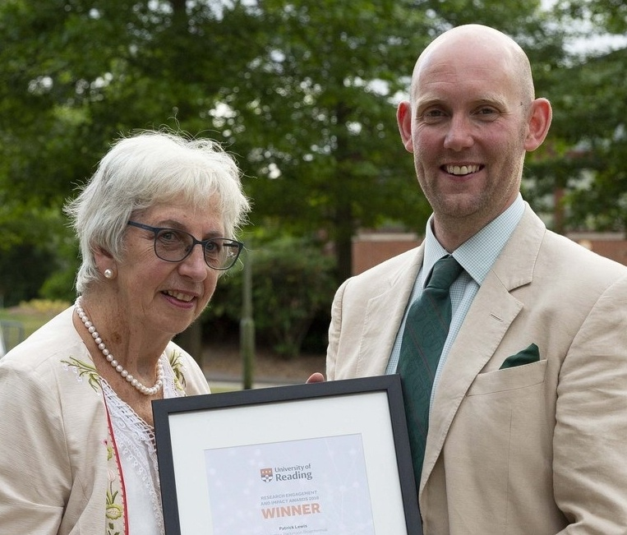
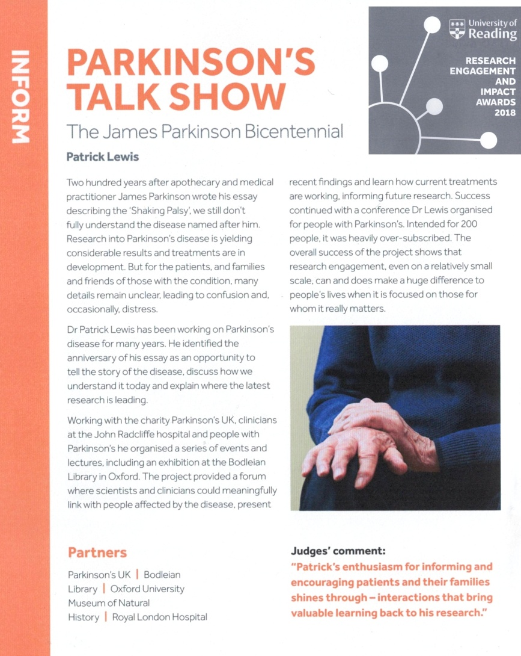
Recognition by Reading University of Dr Patrick Lewis's work for our Conference

Slide 25
Parkinson's 200 Plus
Our conference and related events to mark the 200th anniversary of James Parkinson's "Essay"

Slide 26
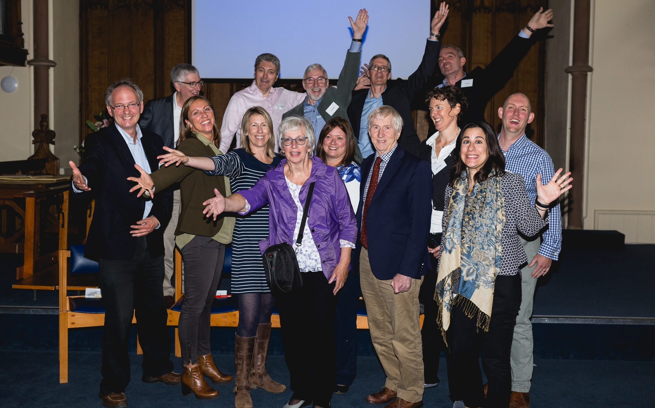
Presenters: researchers, PwP, therapists

Slide 27
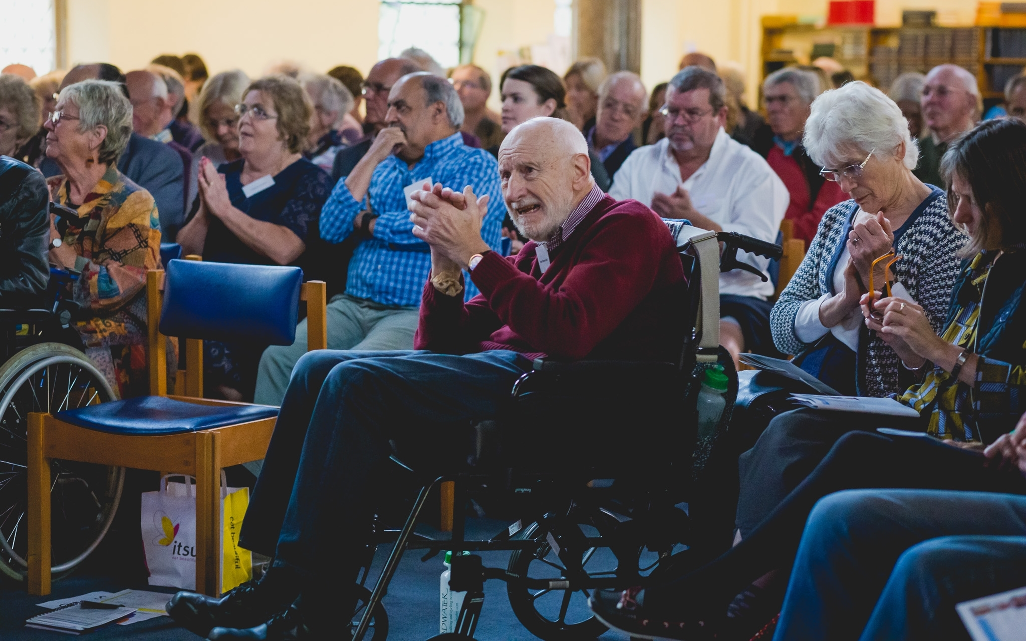
An appreciative audience

Slide 28
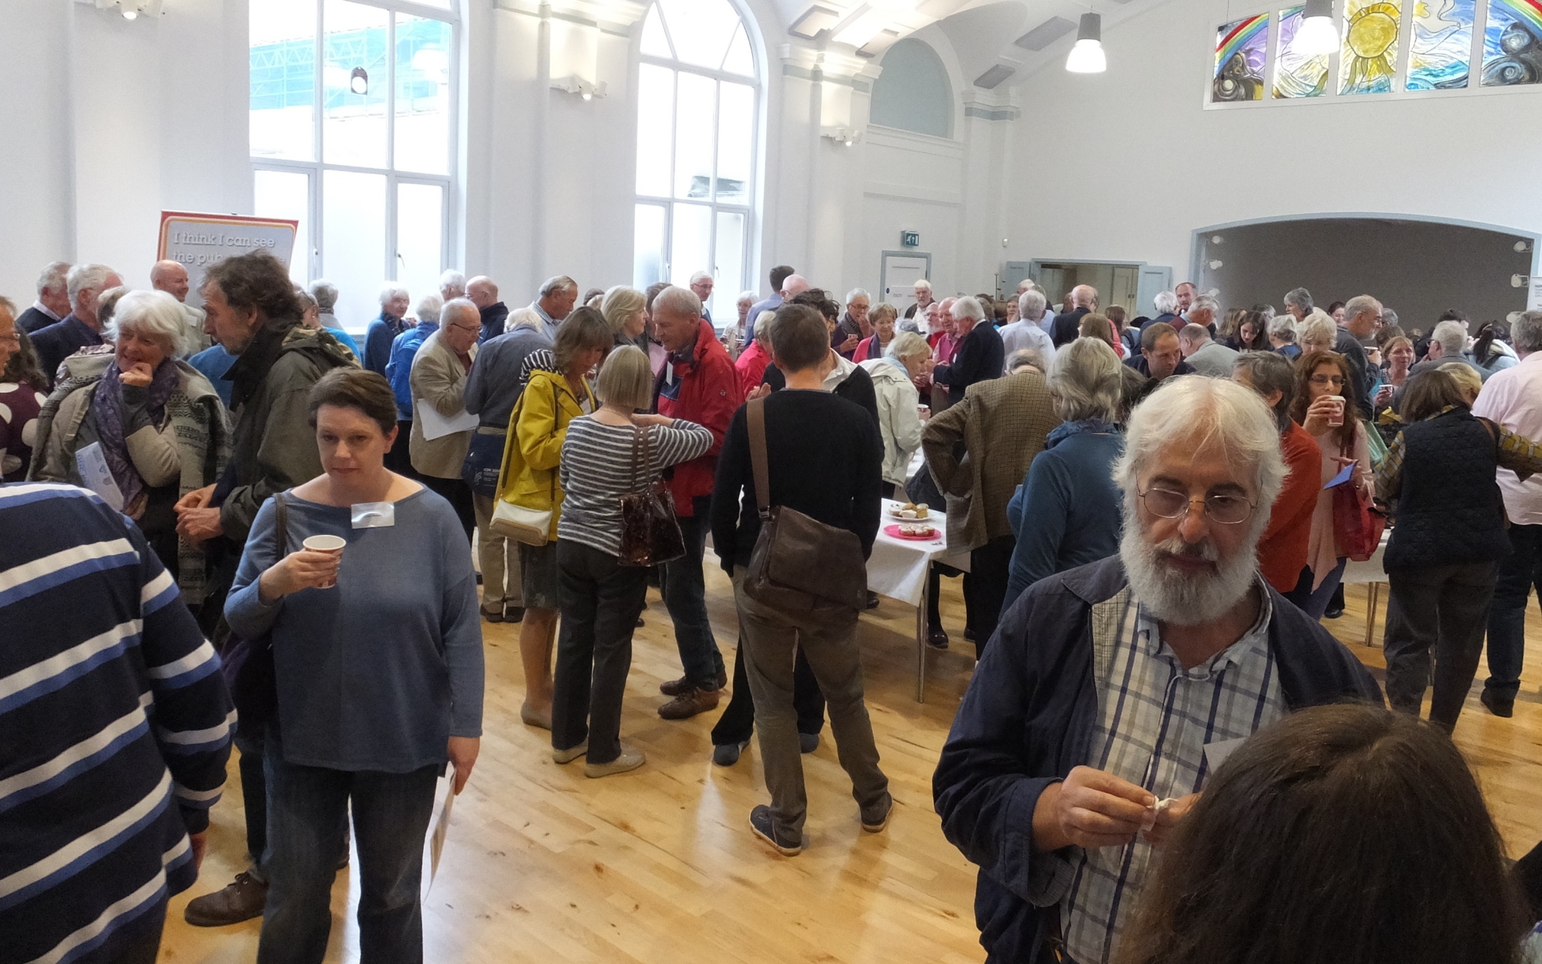
Opportunities to network and discuss

Slide 29
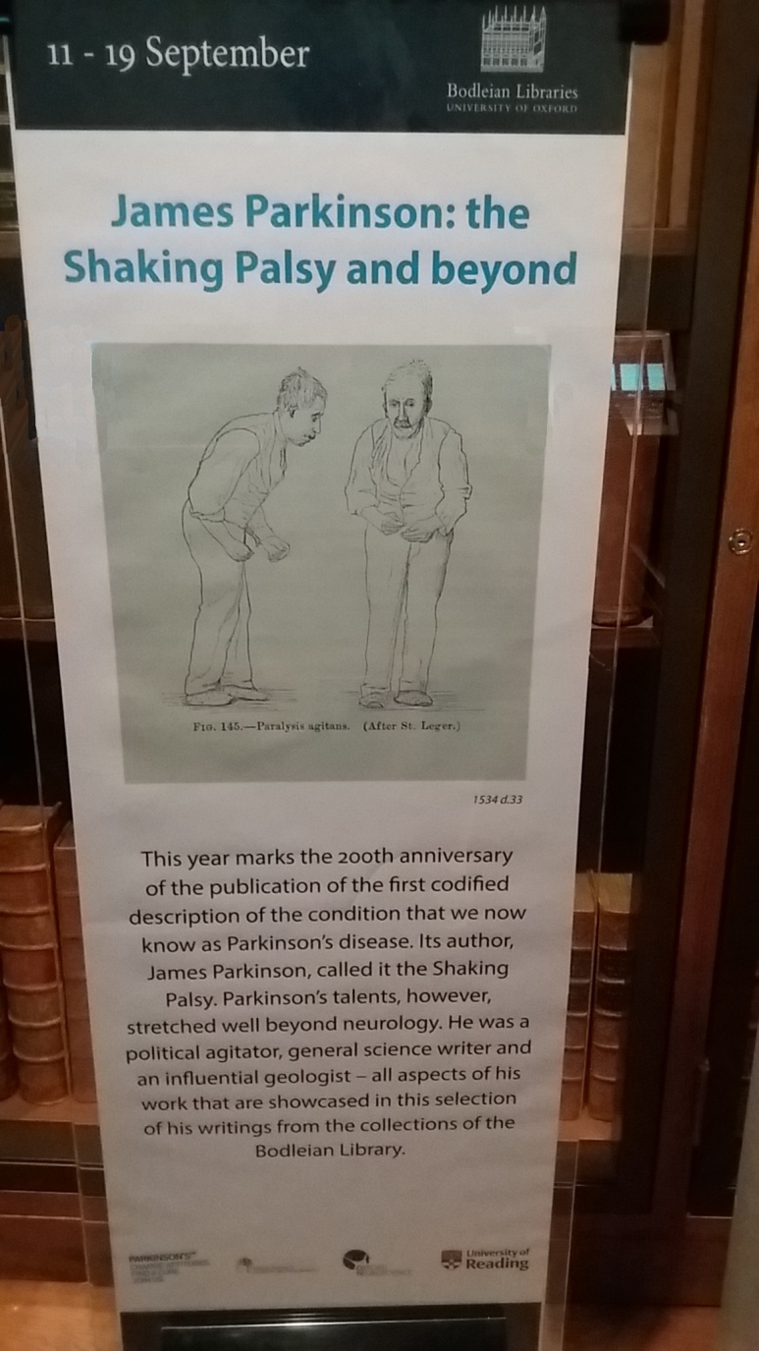
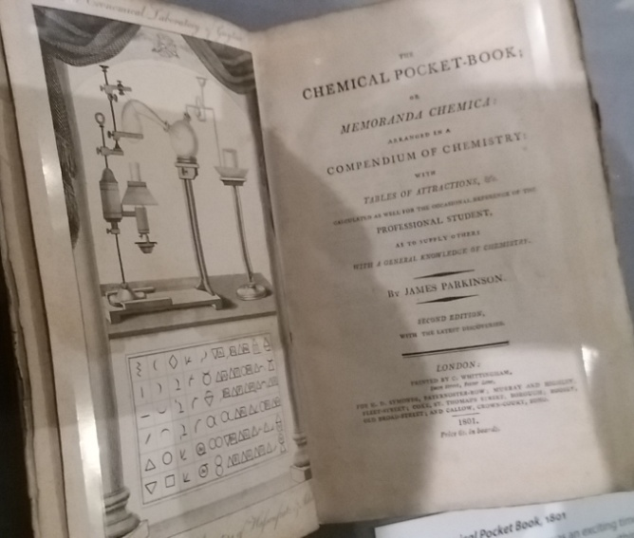
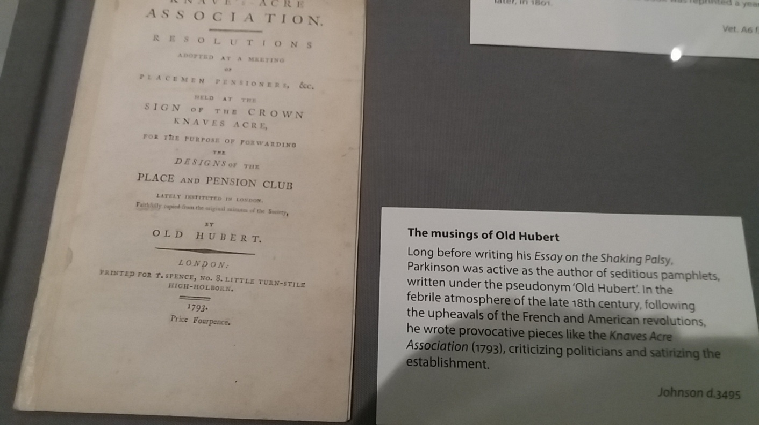
Exhibition at the Bodleian Library

Slide 30
Engaged with research
Some of our visits and activities

Slide 31
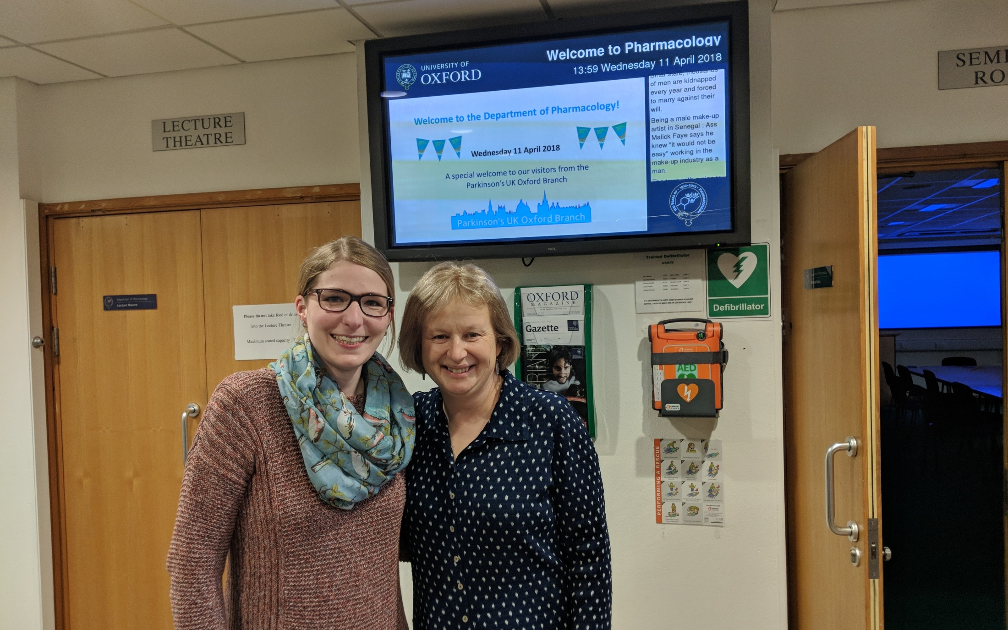
Visit to Prof. Platt's lab

Slide 32
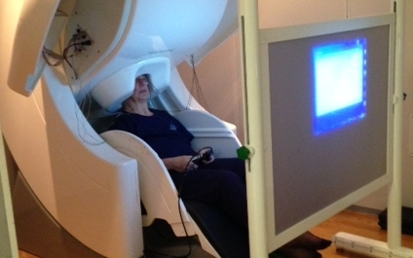
Members act as research volunteers

